Slide 1
Congressional Stock Analysis
Do Congress Members Beat the Market?
Machine Learning on STOCK Act Disclosures · March 2026

Slide 2
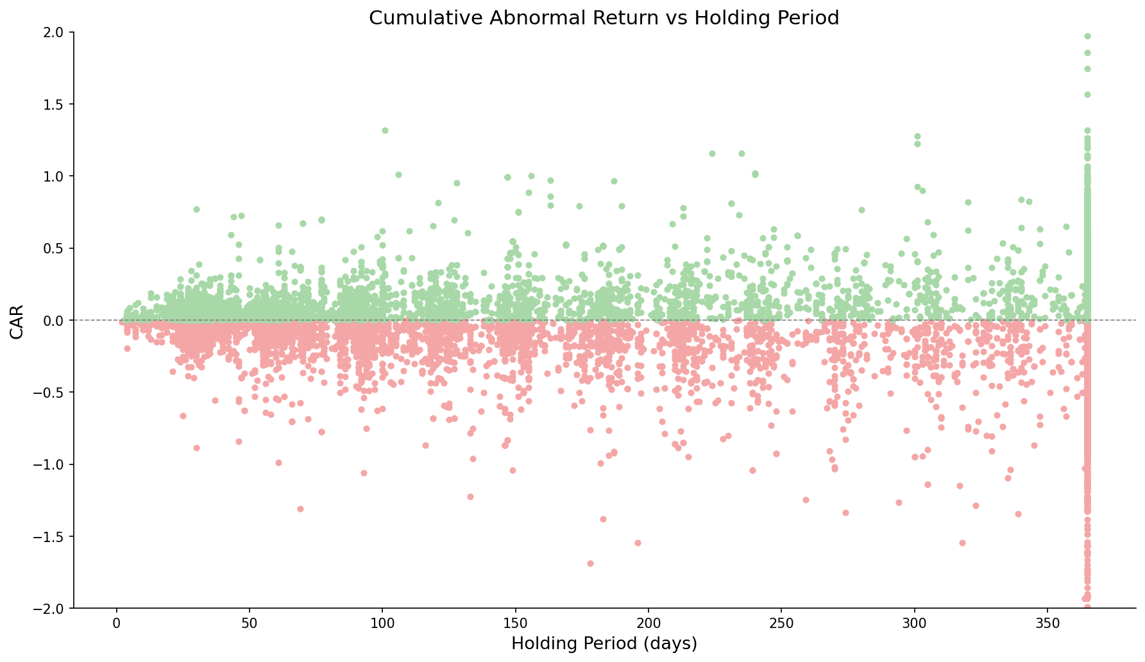
Most Congressional Purchases Underperform the Market
15k
Total modeled trades
-0,5%
Median CAR
48.5%
Win rate

Slide 3
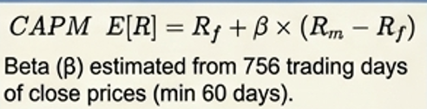
How We Measure Performance: Cumulative Abnormal Return (CAR)
Cumulative Abnormal Return (CAR)
Positive CAR (+)
Negative CAR (-)
Compensated MORE for risk than CAPM predicts
Compensated LESS, paid for risk that did not materialize
For each day, calculate the excess return relative to the stock's expected risk-adjusted return, then accumulate those daily excesses over the window.
Window:
Measured buy-to-sell (if <12 months) or a fixed 12-month window.
The clock starts the day AFTER the public filing date.x
Excess return: actual log return – CAPM-expected log return

Slide 4
Who Consistently Beats — and Loses to — the Market?
▸ Based on 101 politicians with ≥ 20 disclosed purchases

Slide 5
Performance Over Time: Macro Events Drive Positive Rates
▸ 2020 Q2–Q3: surge in positive rate — COVID recovery bounce lifted most purchases
▸ 2022: sharp drop aligned with rate-hike drawdown across the market
▸ Volume spikes suggest increased trading activity around election cycles
▸ Positive rate rarely exceeds 60% — even in the best macro environments

Slide 6
EDA: Median CAR Across Key Structural Variables
▸ All metrics: median CAR (consistent throughout the deck)
▸ Tier 3 = Direct jurisdiction · Tier 2 = Oversight · Tier 1 = Tangential
▸ Disclosure delay capped at 45 days by STOCK Act; 50d+ entries reflect late filers

Slide 7
Committee Membership Shows Selective Advantage
Committee categories (all 9)
Structural role flags
▸ Orange = flag=1 (on committee / in role / company lobbied) · Blue = flag=0
▸ All 9 committee categories shown — previously only 5 were displayed
▸ Lobbied (90d): company had active lobbying disclosure in 90 days before filing date

Slide 8
Can ML do it better?
Confusion matrix @ 0.85
 | Pred: No beat | Pred: Beat
Actual: No beat | TN=1,561 | FP=117
Actual: Beat mkt | FN=1,215 | TP=132
Test set: 3,025 trades
Threshold comparison
Thr | N | % Pos | Med CAR | Prec
50% | 1472 | 47.0% | -0.88% | 47.0%
60% | 1083 | 46.4% | -1.07% | 46.4%
85% | 249 | 53.0% | +0.67% | 53.0%
Threshold 0.85 → 53% win rate · median CAR +0.67% · 249 trades · 53.0% precision

Slide 9
The Model: What Drives the Predictions?
■ Politician Skill
■ Trade Signals
■ Stock Characteristics
■ Committee / Industry
■ Lobbying

Slide 10
Conclusions & Caveats
Key Findings
▸ Most trades underperform: only 48.5% of purchases beat the market
▸ Past politician skill and lobbying activity are among the top model features
▸ Committee membership shows selective lift — most pronounced for Chair and Majority Party roles
▸ Tier-3 committee–industry match (direct jurisdiction) shows the strongest committee-related edge
▸ XGBoost reaches 53.0% precision at threshold 0.85 — fewer but higher-quality trades
Caveats
▸ No transaction costs or market impact modelled
▸ Test set is a single holdout period — results may not generalise across regimes
▸ Skill signals are backward-looking: past performance not guaranteed to continue
▸ CAR is measured from filing date — model already accounts for disclosure lag,
▸ but real-world execution is constrained to after public disclosure
▸ Dataset covers disclosed trades only — undisclosed activity not captured
Potential Data Enrichment (Lobbying Focus)
▸ What more lobby data could add:
▸ 1. Lobbying spend amount & trend (currently: binary 90d presence only)
▸ 2. Issue specificity — which bills/topics overlap with politician's committee jurisdiction
▸ 3. Revolving door: lobbyists who previously worked for the same politician/committee
▸ 4. Proximity signal: days between lobbying start date and trade filed date

Slide 11
Methodology: How Key Signals Were Constructed
1 — Ticker ↔ Committee Matching
▸ Committee membership from timestamped YAML snapshots (unitedstates/congress-legislators on GitHub)
▸ For each trade, the snapshot closest in time to the Filed date is used
▸ Ensures membership reflects the politician's actual committees at trade time
▸ Committee codes truncated to 4 characters to normalize across snapshot formats
▸ Result: binary committee-category flags per trade (9 categories total)
2 — 3-Tier Committee–Industry Match
▸ Manual mapping in config/commette_industry_map.yaml: committee → sector → industry
▸ Tier 3 (Strong): committee has DIRECT JURISDICTION — controls budgets, contracts, or legislation
▸ Tier 2 (Medium): committee has OVERSIGHT — sets general rules, taxes, or compliance standards
▸ Tier 1 (Tangential): committee has INDIRECT impact — general legislative influence only
▸ Result: Industry match 1/2/3 binary flags per trade (1 = politician's committee matches stock's industry at that tier)
3 — Lobbying Signal
▸ Source: QuiverQuant lobbying disclosures API, downloaded per traded ticker
▸ lobbied_any_90d = 1 if the company had any active lobbying disclosure in 90 days before trade's Filed date
▸ Currently binary — lobbying spend amount and issue specificity are future enrichment candidates

Slide 12
APPENDIX
Dataset Overview
39,334
19,096
15,117
268
Total Records
Purchases
Modelled
Politicians
Metric | Value
Date range | 2012-09-13 – 2026-01-30
Transaction types | Purchase / Sale / Sale (Full) / Sale (Partial) / Exchange
Unique tickers (purchases) | 2,209
Parties | D / R / I
Chambers | Representatives / Senate
Target variable | realized_car_hybrid > 0 (binary)
CAR windows available | 1m / 3m / 6m / 9m / 12m + realized
Train / test split | 80% / 20% chronological

Slide 13
Committee Membership Shows Selective Advantage
Committee categories (all 9)
Structural role flags
▸ Orange = flag=1 (on committee / in role / company lobbied) · Blue = flag=0
▸ All 9 committee categories shown — previously only 5 were displayed
▸ Lobbied (90d): company had active lobbying disclosure in 90 days before filing date

